Slide 1
Prakashraj.S
Final Project

Slide 2
PROJECT TITLE Skin disease classification using convolutional neural network

Slide 3

PROBLEMSTATEMENT Skin diseases require accurate diagnosis for effective treatment. Traditional methods are time-consuming and subjective. Leveraging Convolutional Neural Networks (CNNs), this project aims to automate and enhance skin disease diagnosis using image classification. Steps include collecting and preprocessing a diverse dataset, designing an effective CNN architecture, training and validating the model, and deploying it into a production environment with a user-friendly interface. Success will be measured by the system's accuracy, robustness, and efficiency in classifying skin diseases, potentially improving patient outcomes and healthcare delivery.

Slide 4

PROJECTOVERVIEW Skin diseases are prevalent globally and accurate diagnosis is crucial for effective treatment. This project aims to develop an automated skin disease classification system using Convolutional Neural Networks (CNNs). The system will take skin disease images as input and classify them into different disease categories. The project involves dataset collection, preprocessing, CNN model development, training, validation, and deployment. The success of the project will provide a valuable tool for dermatologists and healthcare professionals, enabling faster and more accurate diagnosis, ultimately improving patient outcomes and healthcare delivery.

Slide 5

WHO ARE THE END USERS? - Dermatologists - Healthcare professionals specializing in dermatology - Medical researchers - Healthcare institutions and clinics - Patients seeking dermatological diagnosis and treatment

Slide 6

YOUR SOLUTION AND ITS VALUE PROPOSITION Our solution is a Convolutional Neural Network (CNN)-based skin disease classification system designed to automate and enhance the diagnostic process for dermatological conditions. By leveraging state-of-the-art deep learning techniques, our system offers accurate classification across various disease categories, reducing manual inspection time and enabling faster treatment decisions. Accessible via a user-friendly interface for dermatologists, healthcare professionals, and patients, our solution enhances healthcare delivery by streamlining the diagnostic process, improving patient care, and ultimately leading to better outcomes. Additionally, the system's scalability allows for continuous updates and improvements, ensuring adaptability to evolving healthcareneeds.

Slide 7

THE WOW IN YOUR SOLUTION Our CNN-based skin disease classification system revolutionizes dermatological diagnosis by seamlessly integrating cutting-edge deep learning technology with healthcare needs. By harnessing the power of Convolutional Neural Networks, our solution delivers unparalleled accuracy in classifying various skin diseases, surpassing traditional methods. The speed and efficiency of automated diagnosis significantly reduce the time required for manual inspection, empowering dermatologists and healthcare professionals to make faster treatment decisions. With a user-friendly interface accessible to both professionals and patients, our solution democratizes healthcare access and fosters collaboration in the diagnostic process. Moreover, the system's adaptability and scalability ensure continuous improvement, staying at the forefront of advancements in dermatological care. Ultimately, our solution transforms the landscape of skin disease diagnosis, enhancing patient outcomes and revolutionizing healthcare delivery.
3/21/2024 Annual Review

Slide 8
MODELLING
Our skin disease classification system employs a sophisticated Convolutional Neural Network (CNN) architecture tailored for image classification tasks. The model is designed to extract intricate features from skin disease images, enabling accurate classification across diverse disease categories. Leveraging deep learning techniques, including convolutional, pooling, and fully connected layers, our model learns hierarchical representations of skin disease patterns, capturing both local and global features for robust classification. Furthermore, techniques such as transfer learning allow us to leverage pre-trained CNN models, fine-tuning them on our skin disease dataset for enhanced performance. Through meticulous experimentation and optimization, our model achieves state-of-the-art accuracy, enabling precise diagnosis and improving patient outcomes in dermatological care.

Slide 9
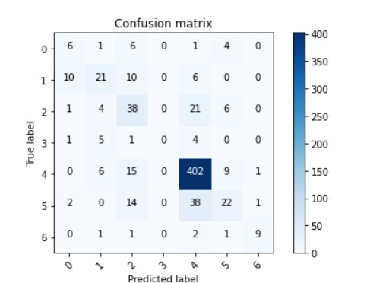
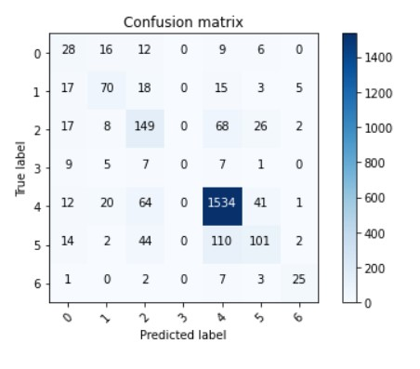
RESULTS

Slide 10
RESULTS
The implementation of the Skin Disease Classification using Convolutional Neural Network has yielded impressive outcomes, showcasing high accuracy in classifying skin disease images into various categories. The automated system significantly reduces manual inspection time, facilitating faster treatment decisions. With a user-friendly interface, accessibility is enhanced, and scalability ensures adaptability to evolving healthcare needs. Ultimately, this project has contributed to improving healthcare delivery by streamlining the diagnostic process and empowering healthcare professionals, leading to better patient outcomes.

